Slide 1
Graphic Engine in WebGl
Interactive Graphics Project
By Federico Matarante

Slide 2
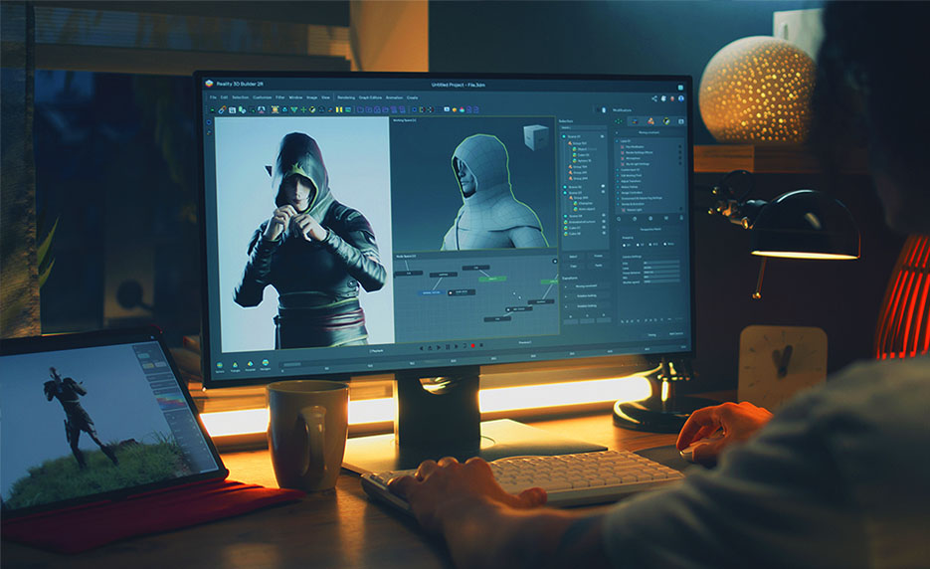
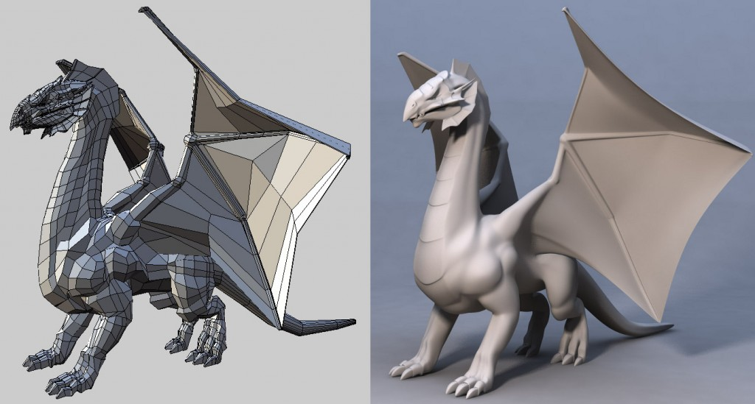
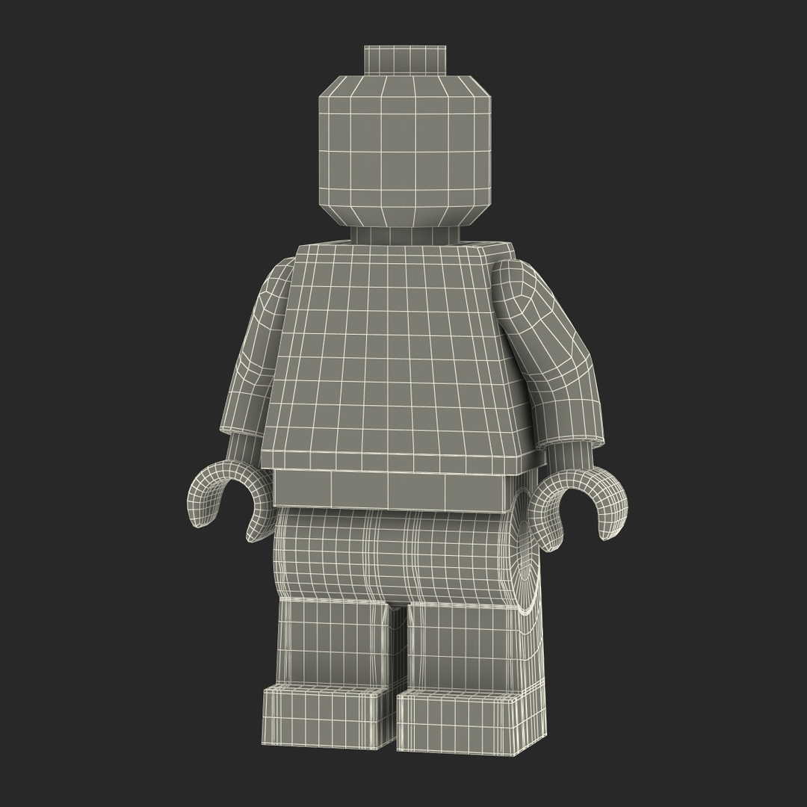
Possible applications
Game Development
Model Visualization
3D Modelling

Slide 3
Engine Features
Real time rendering
Support for models in the .obj/.mtl standards
Multiple textures support
Diffuse, normal, specular, shininess, ambient and emission textures supported
Object transformations support
Point light format
Light and camera settings customization

Slide 4
Rendering design choices
Adapting bi-linear/tri-linear filtering of textures
Clamp-to-edge textures
Supported polygons and lines
Smooth normals interpolation
3 levels of illumination supported
Blinn-Phong + ambient + emission reflection model

Slide 5
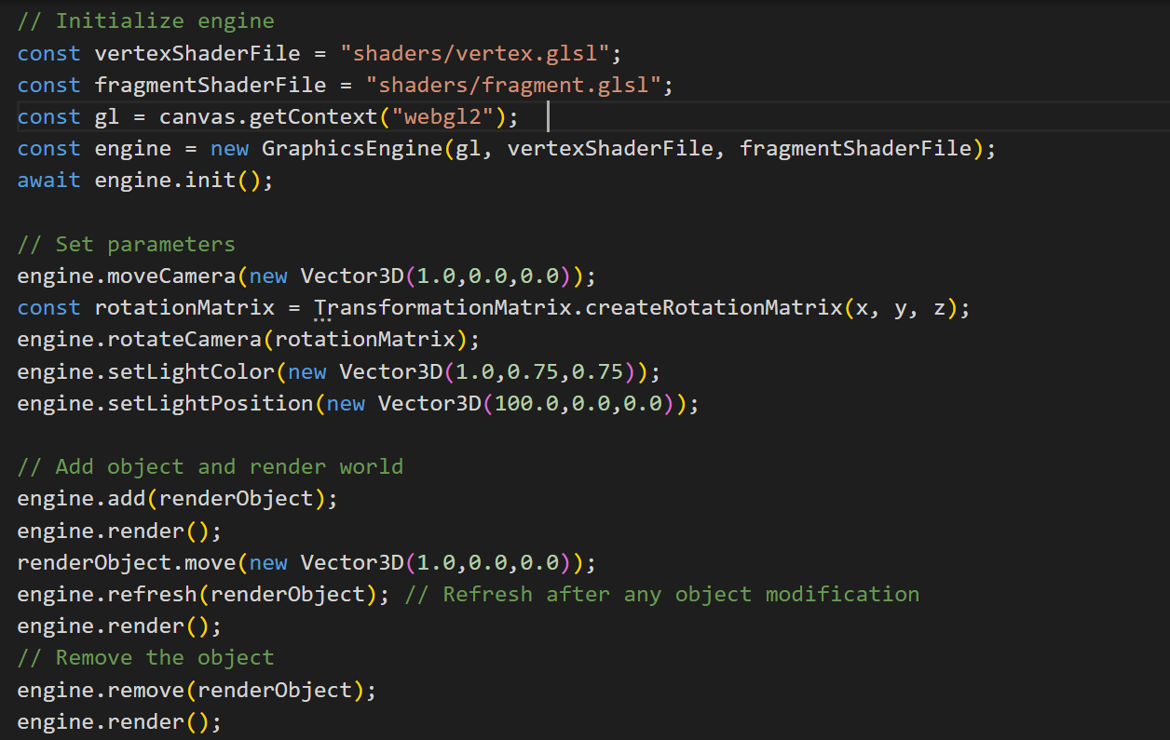
How to use the engine?

Slide 6
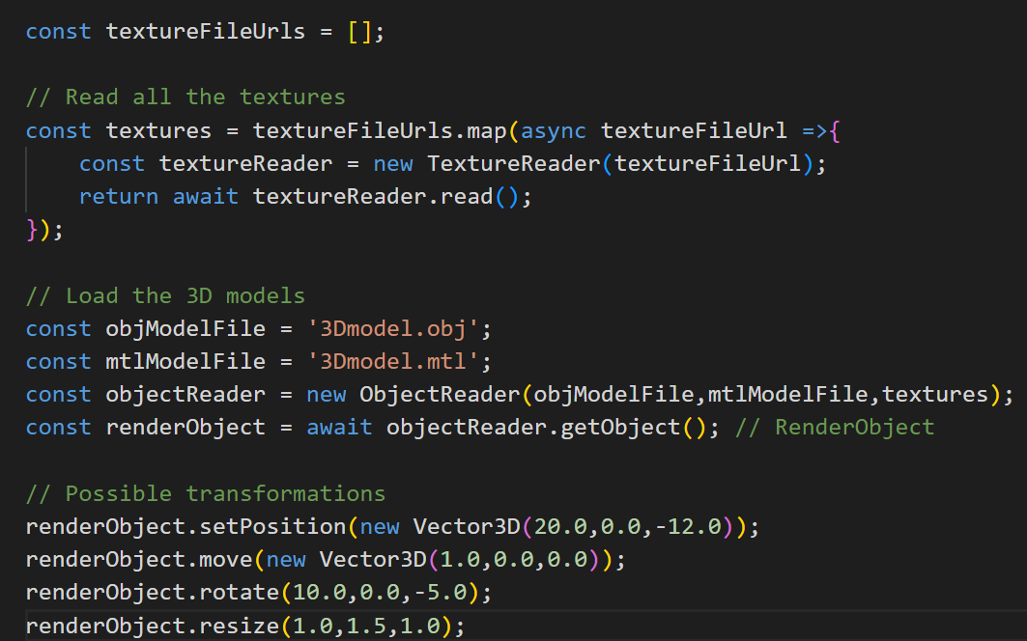
How to load and manipulate models?

Slide 7
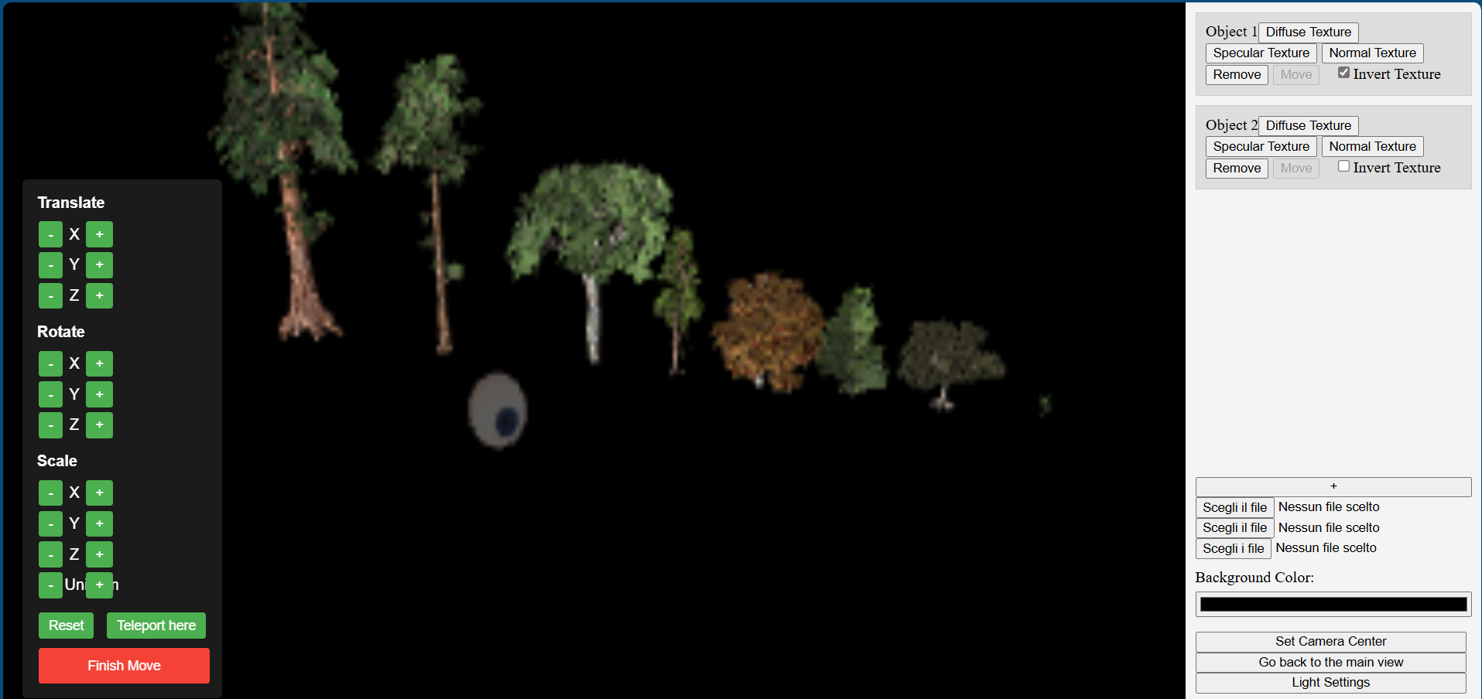
Models Visualizer

Slide 8
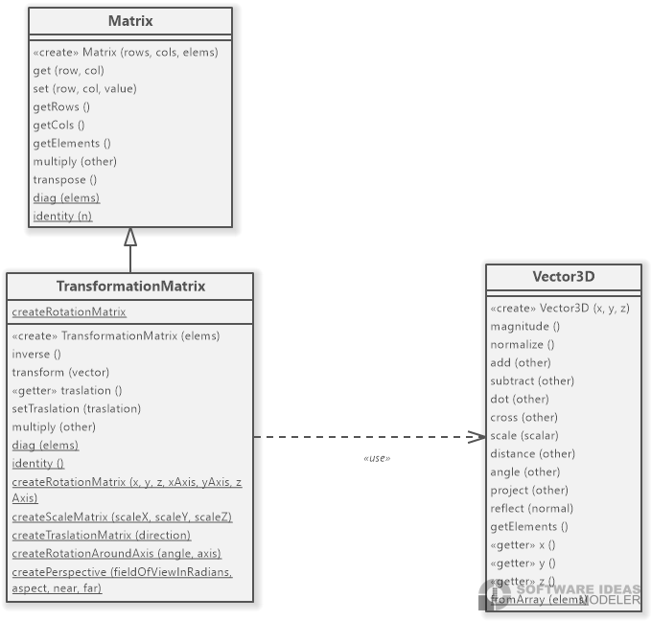
Class diagrams (1)

Slide 9
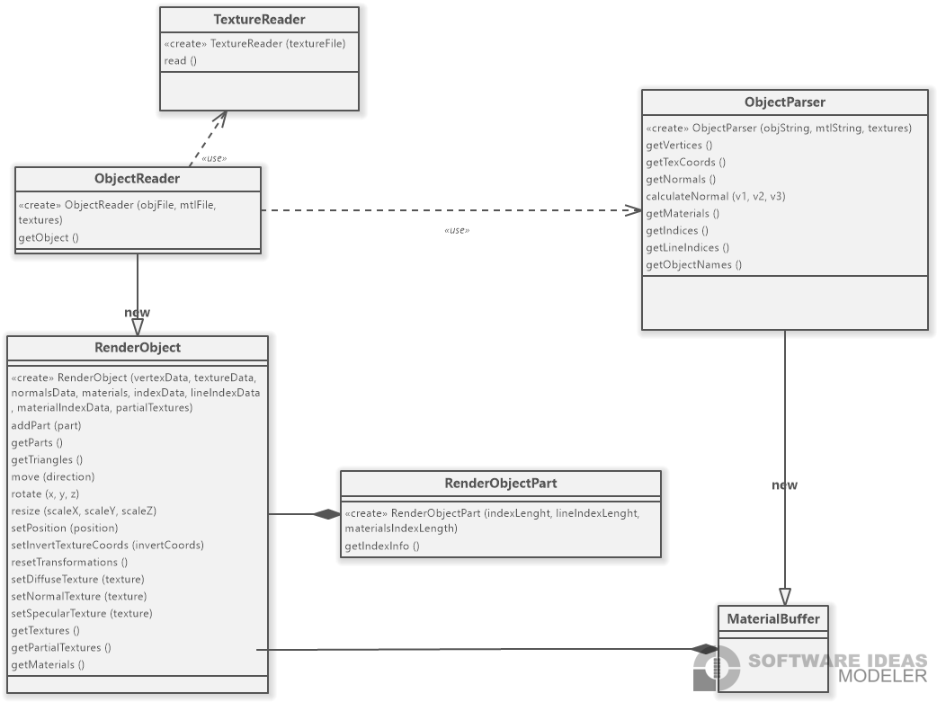
Class diagrams (2)

Slide 10
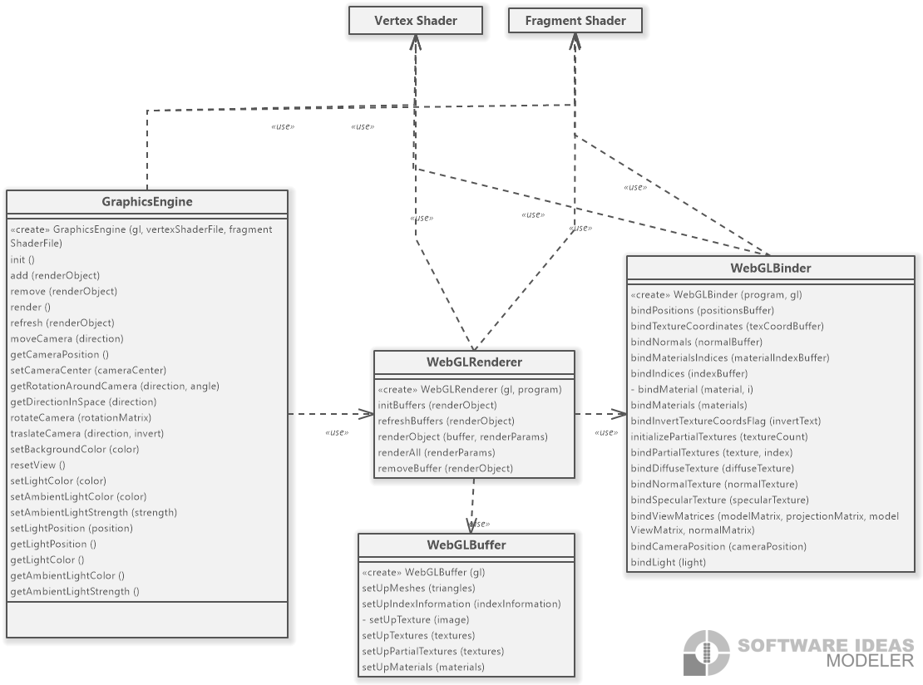
Class diagrams (3)

Slide 11
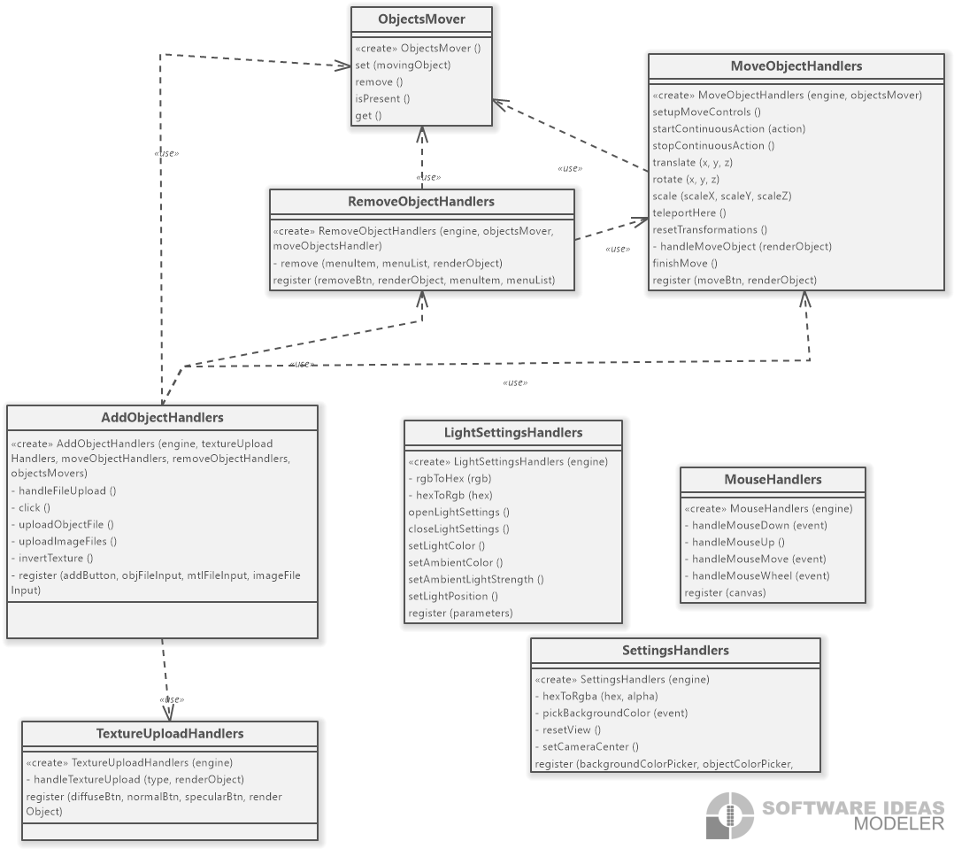
Class diagrams (4)

Slide 12

Room for improvement?
Ray tracing support
Memory and computational optimization
Support for more textures and more materials ( now limited )
Default shapes support
Advanced customization of rendering settings

Slide 13
Thank you for your attention!
Thank You For Your Attention!

